Slide 1

DATA FIESTA 3.0

Slide 2
Problem
Statement
ABC Inc. is a Custom products distributor with majority in cosmetics products selling to different types of stores across the U.S but also internationally.
They are interested in getting a better understanding of their Sales, AUR, COGS and Margin performance across their business.
As it a very large organization with a dynamic business, its top executives need to have look at the data generated on daily basis and take the business decisions accordingly. This has become major challenge for ABC Inc.

Slide 3
TOP INSIGHTS
After analyzing the given data for ABC Inc. We came to the following conclusions:
The average for the Best product for tenure ‘2017-2019’ is SILK-CANVAS which generated the avg. Revenue of Rs. 173,442.13/-
The average for the Best revenue generator for tenure ‘2017-2019’ is WATER-CREAM which generated the avg. Revenue of Rs. 10,208,776.35/-
ABC Inc.'s overall business stats are
Total Revenue - Rs. 261,581,823.32/-
Net Sales - Rs. 10,713,364.11/-
AUR - Rs. 24.42/-
The Gross Profit generated by the company is Rs. 253,080,505.43/- at the Gross Margin of 96.75%
The COGS value is around Rs. 8,501,317.89/- at COGS% of 3.25%
The Maximum demand is found at Channel 6, Channel 1 & Channel 7, generating total sales of Rs. 4,698,993.39/-
ABC Company’s Maximum products were launched in the year 2018 taking to the no. of 232 & generating sales of Rs 459670.098/-
The Highest Revenue produced by the company was Rs. 125,048,999.46/- at 83.72% in the financial year 2018
The Highest Sales produced by the company was Rs. 2,402,803.76/- at 118.79% in the financial year 2018
For the financial year 2019, yearly sales decreased by 39.54% & sudden decrease in the Revenue can also be seen with a %age of 44.33%

Slide 4
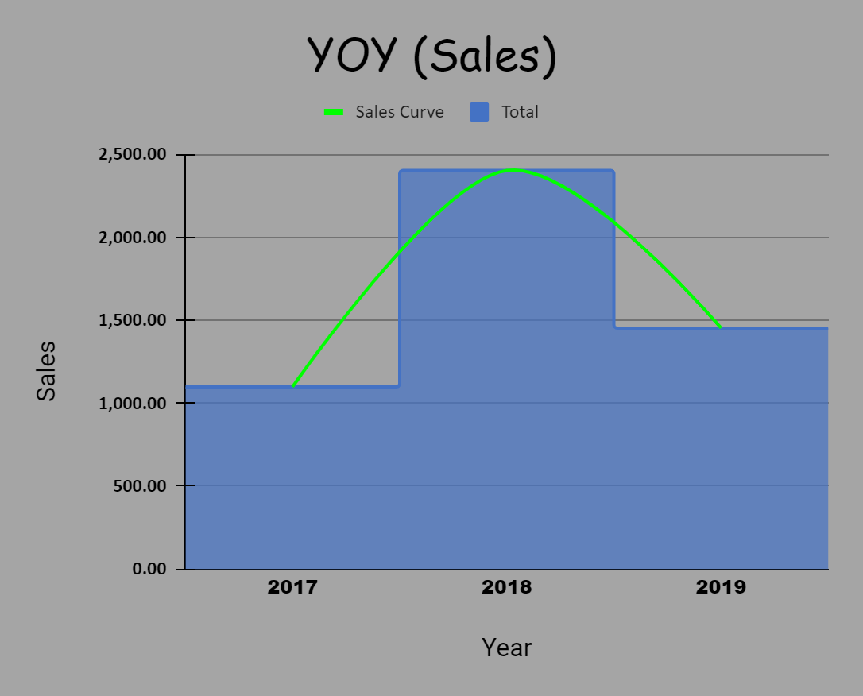
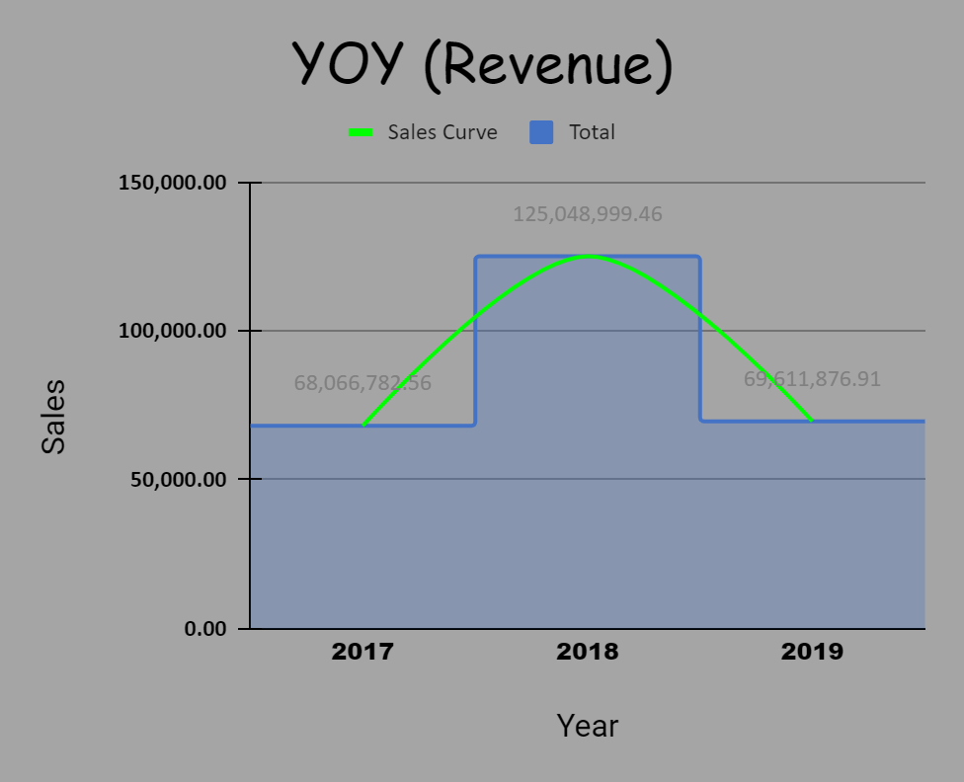
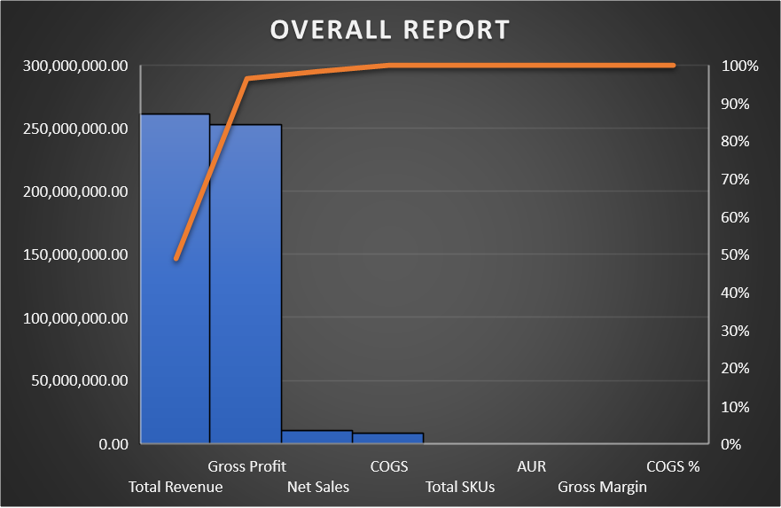
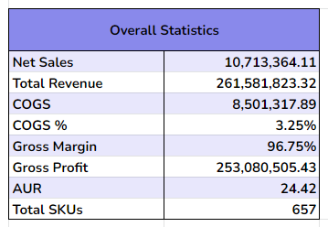
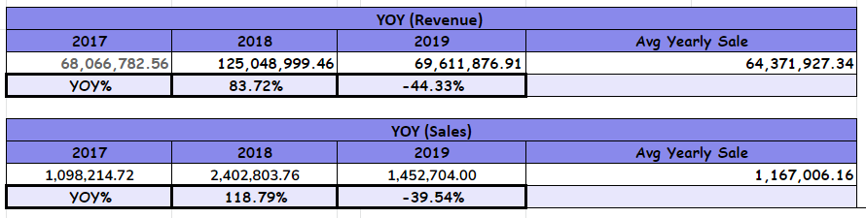
DASHBOARD
YOY% (Revenue, Sales) & Overall Stats

Slide 5
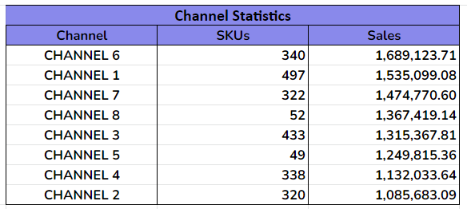
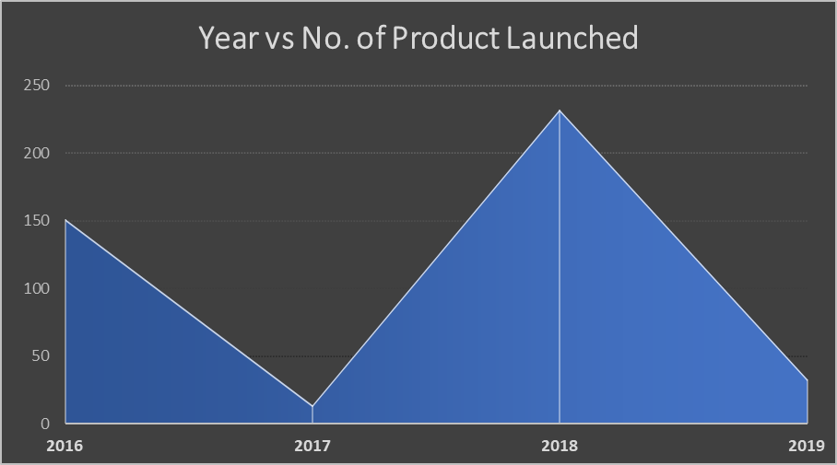
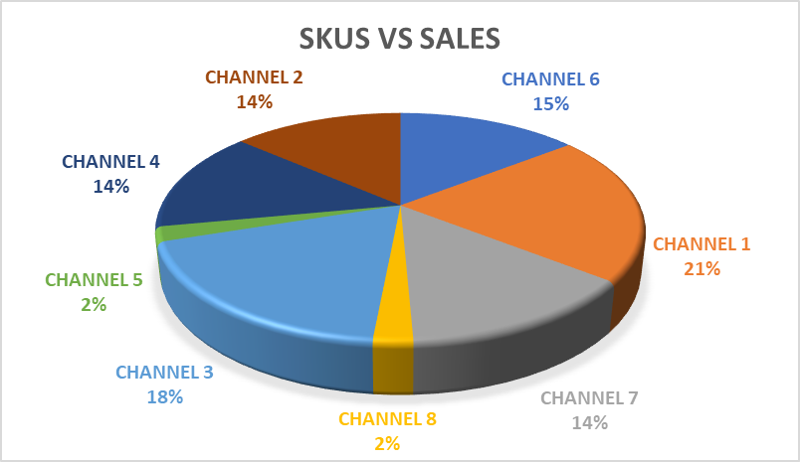
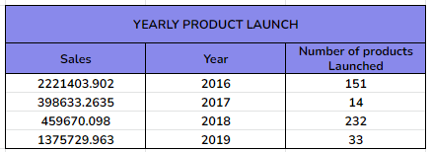
DASHBOARD
Channel Stats & Products Launched

Slide 6
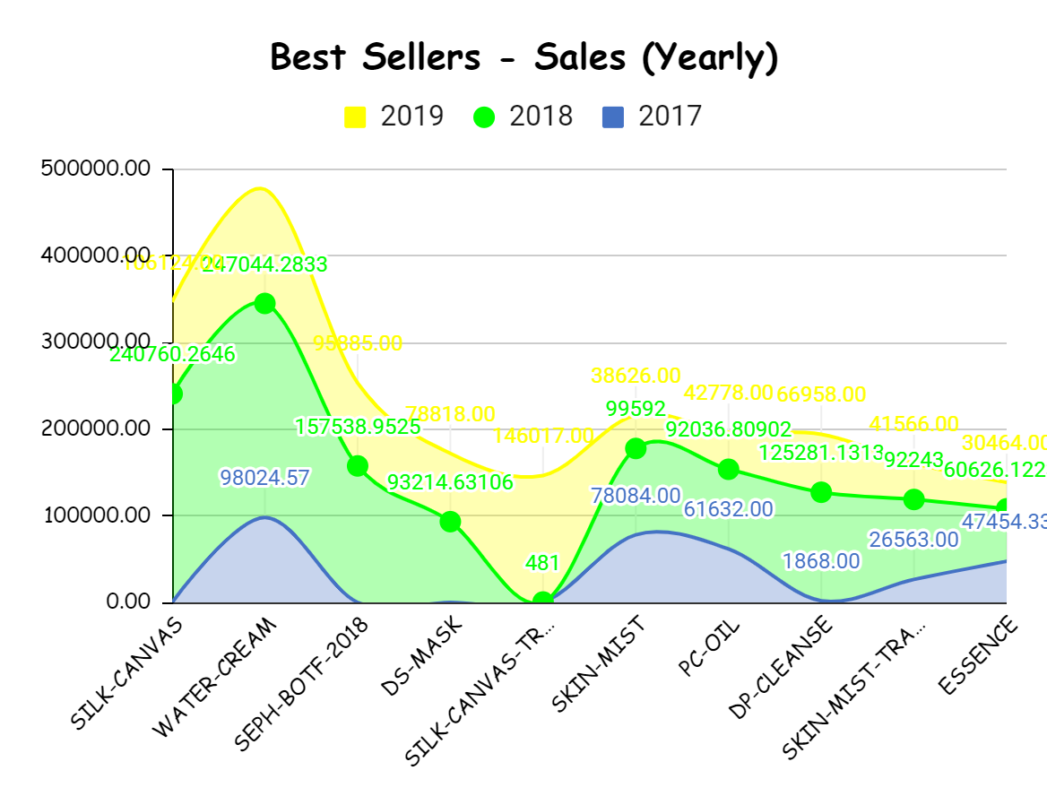
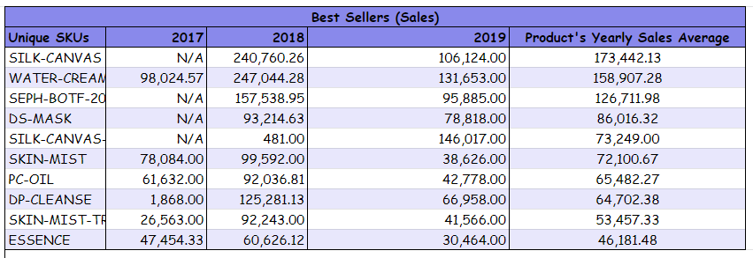
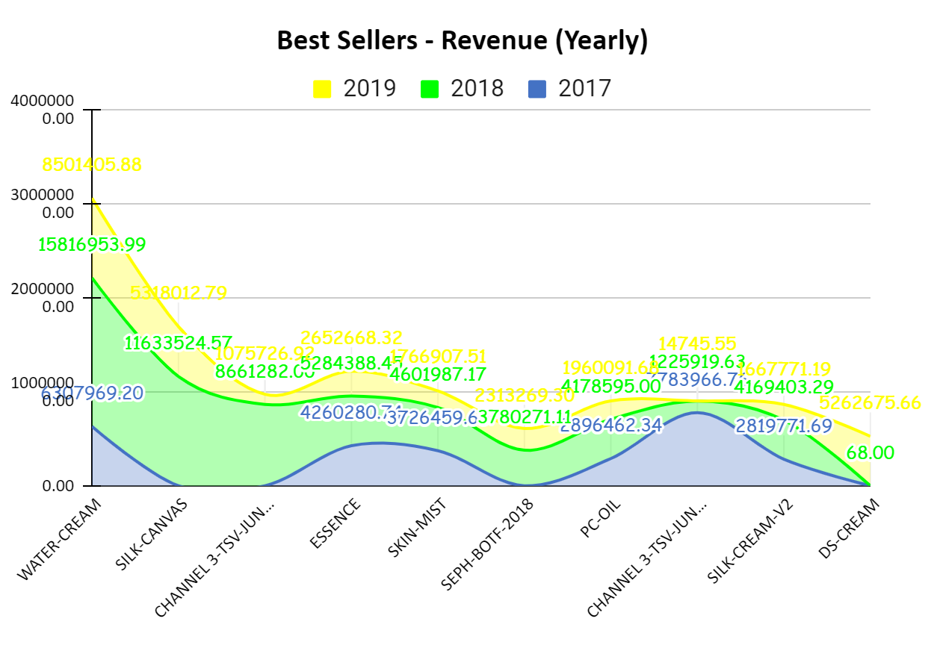
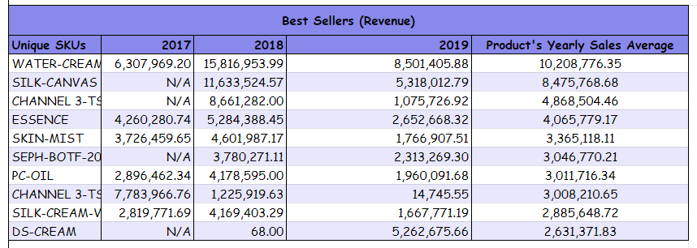
DASHBOARD
Best Sellers (Sales & Revenue)

Slide 7
Important links
Google Drive link - CLICK HERE
Contents of Drive
Google Spreadsheet (for calculations)
MS Excel (for data visualisation - PowerBI)
Data Fiesta 3.0 Solution Presentation

